Slide 1

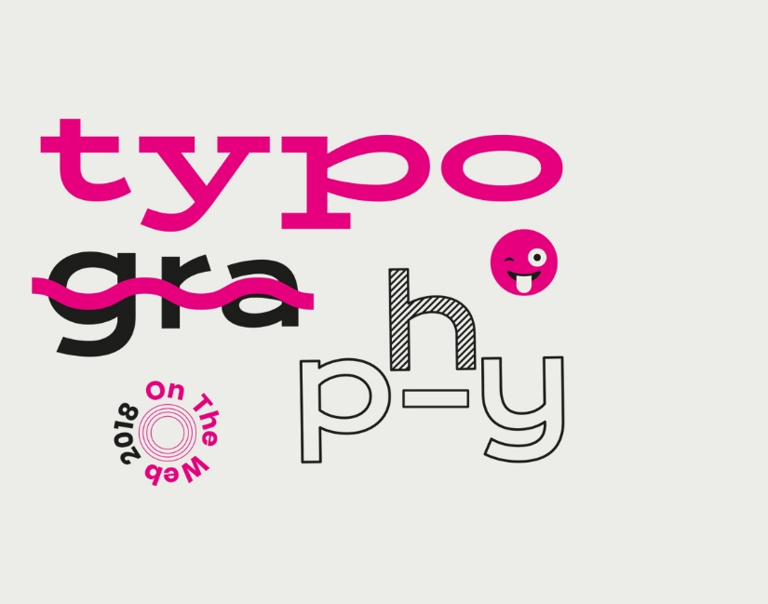
Today’s Content
Typography
Leading
Kerning
Tracking
Hierarchy
Web Fonts & Web Safe Fonts

Slide 2
What is typography?
"What do you do?"
"I’m a typographer."
"Oh, you’re a topographer. So does that mean you have a geology background, or you mostly work with maps?"
"Erm, not exactly. I’m a typographer, I work with fonts."
"Funds? Like an investment banker?"
https://www.commarts.com/columns/how-to-explain-why-typography-matters

Slide 3
Typography is the art and technique of arranging type to make written language legible, readable, and appealing when displayed.
The arrangement of type involves selecting
typefaces,
sizes,
line lengths,
line-spacing (leading),
letter-spacing (tracking), and
adjusting the space between pairs of letters (kerning).
Notes:
https://en.wikipedia.org/wiki/Typography
What is the difference between typeface and Font
https://www.youtube.com/watch?v=wa3mkBP7r70
https://www.fonts.com/font/monotype/arial

Slide 4
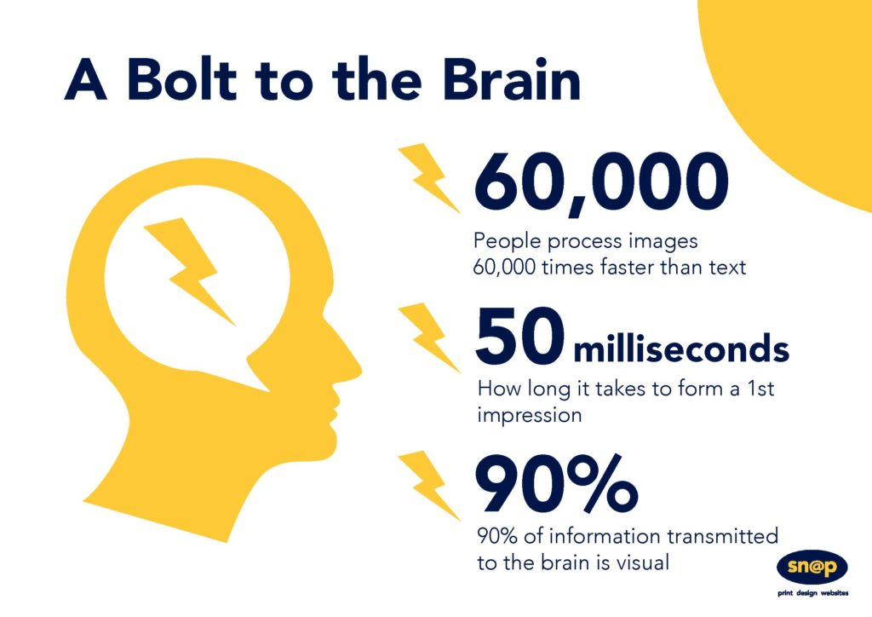
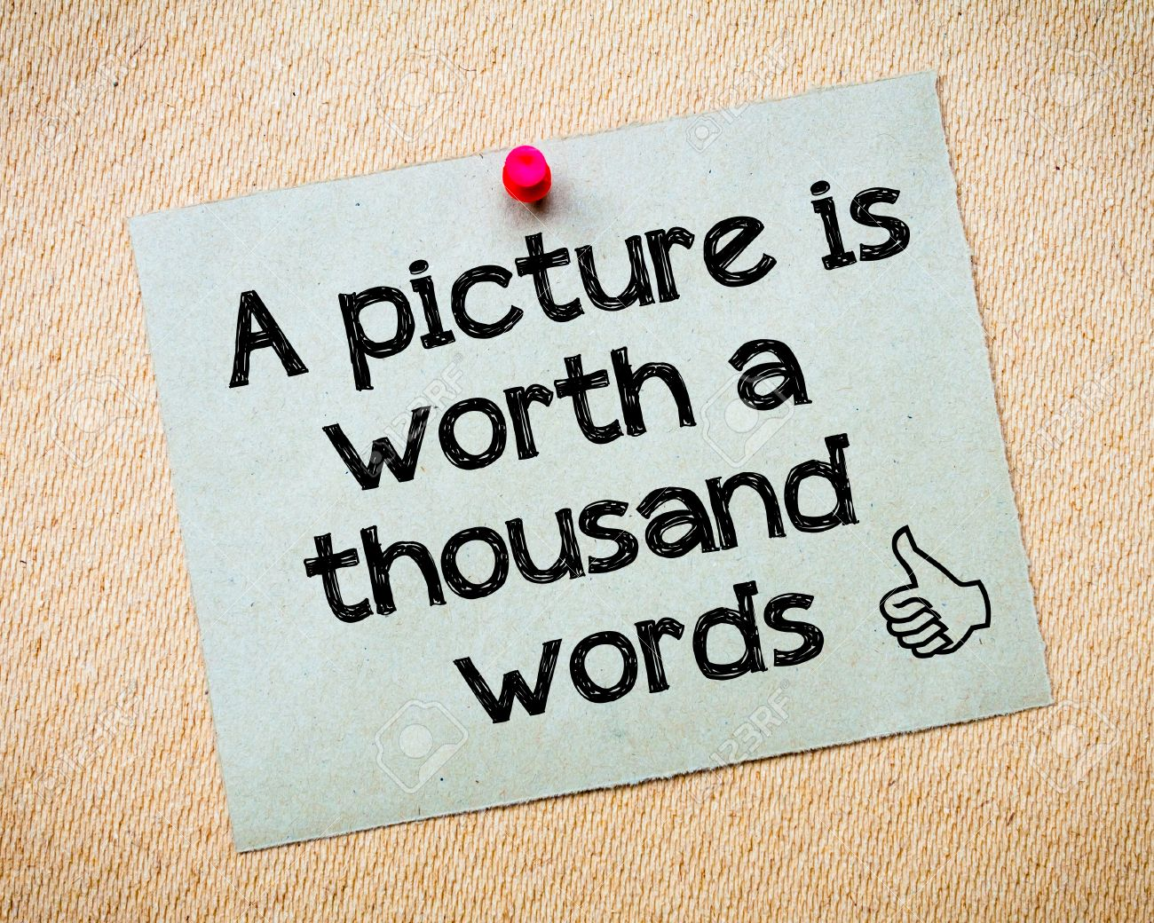
Does that mean words are not important?

Slide 5
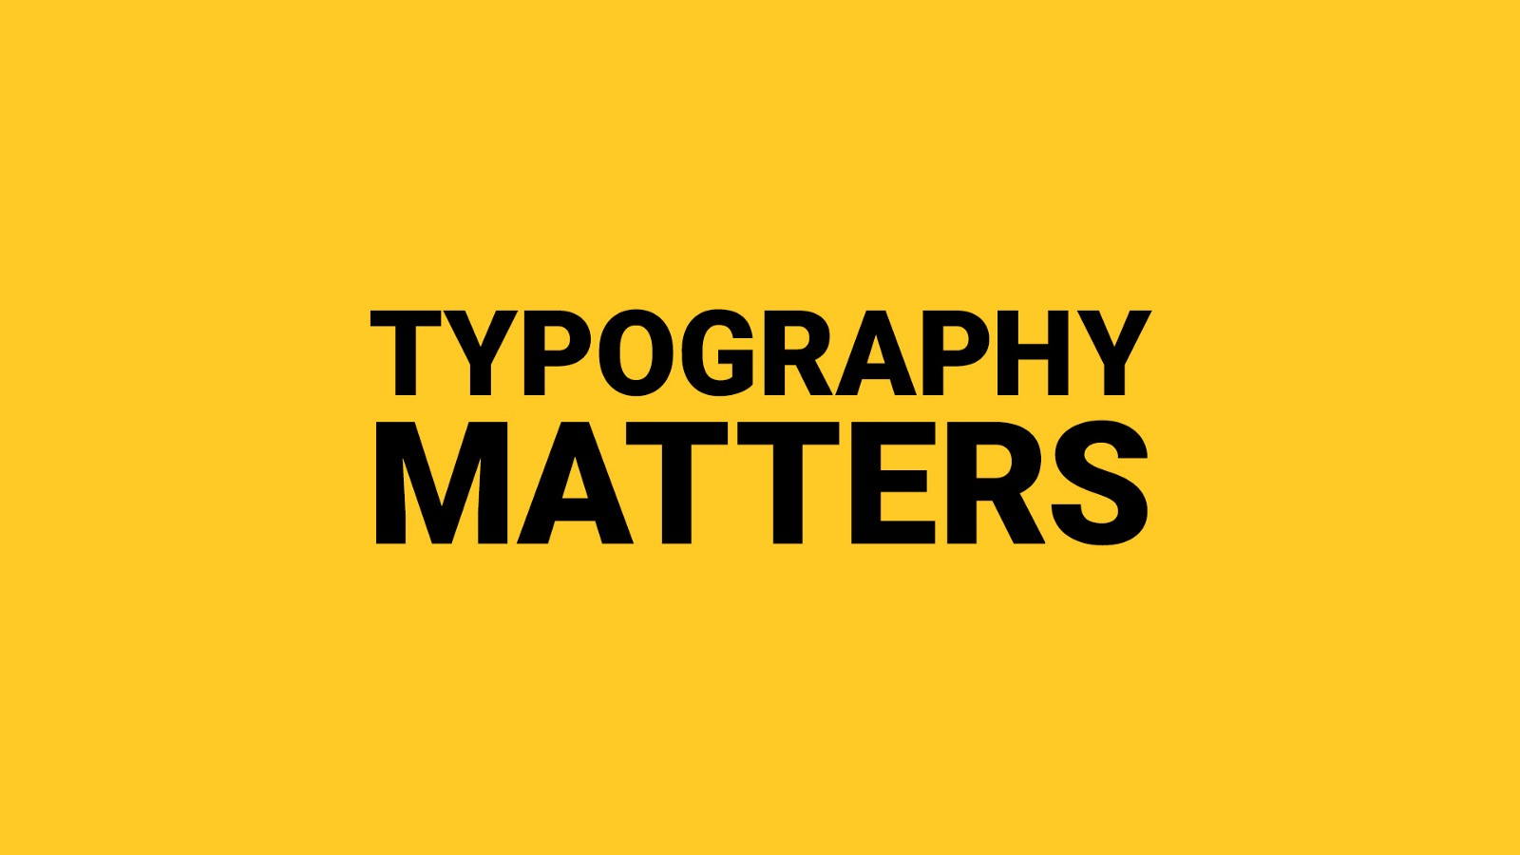
Typography
Notes:
https://www.websitebuilderexpert.com/designing-websites/pick-best-font-style-for-website/
https://www.smashingmagazine.com/2018/06/reference-guide-typography-mobile-web-design/
https://material.io/design/typography/understanding-typography.html#system-fonts
https://www.youtube.com/watch?v=sByzHoiYFX0

Slide 6
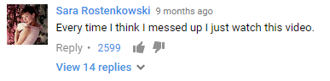
Why Typography Matters — Especially at the 2017 Oscars
https://www.youtube.com/watch?v=8KeOxeuiZjs
http://www.slate.com/blogs/browbeat/2017/02/27/moonlight_wins_best_picture_as_incredible_twist_ending_makes_2017_oscars.html

Slide 7
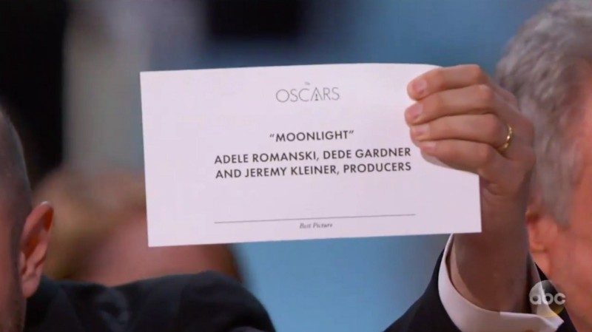
Original televised screenshot. Image: ABC

Slide 8

Reconstructed the card Warren and Faye would’ve seen
Notes:
https://medium.freecodecamp.org/why-typography-matters-especially-at-the-oscars-f7b00e202f22

Slide 9

Modified version of the wrong card. Image: benjamin bannister

Slide 10
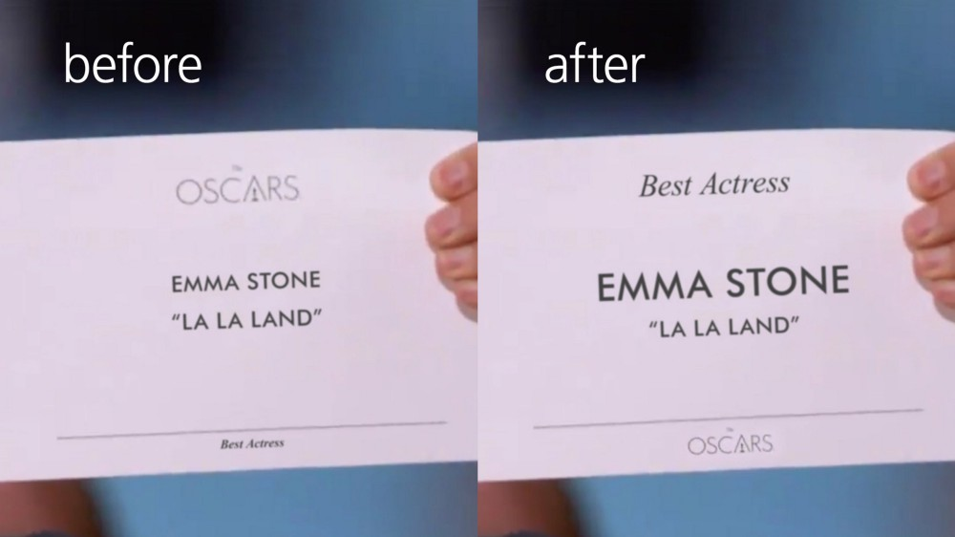
Same text, same elements, but different styling. Image: benjamin bannister
Notes:
The logo doesn’t need to be at the top. Everyone knows it’s the Oscars. We move the Oscar logo to the bottom where it’s least important in this context.
The award category, “Best Actress,” is moved to the top so that it’s the first thing anyone sees and reads. There is no confusion what the category is because it’s clearly stated first.
Emma Stone’s name is bigger than the title, “La La Land,” because she is the winner of this category. The winner should be the most emphasized thing on the card with all other information, like the film’s title, in a smaller or a less thick font (I understand that the text can only be so big so as to have a consistent look for all the cards, while accommodating longer names).

Slide 11
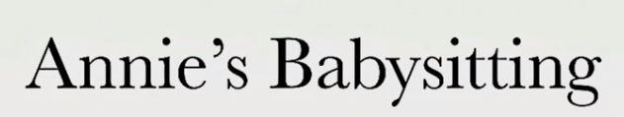
You are looking for a babysitter. Here is what you found online
https://www.youtube.com/watch?v=C_RzDqgGcao

Slide 12
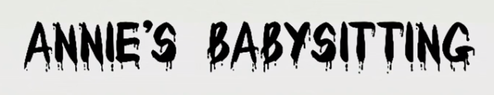

Slide 13
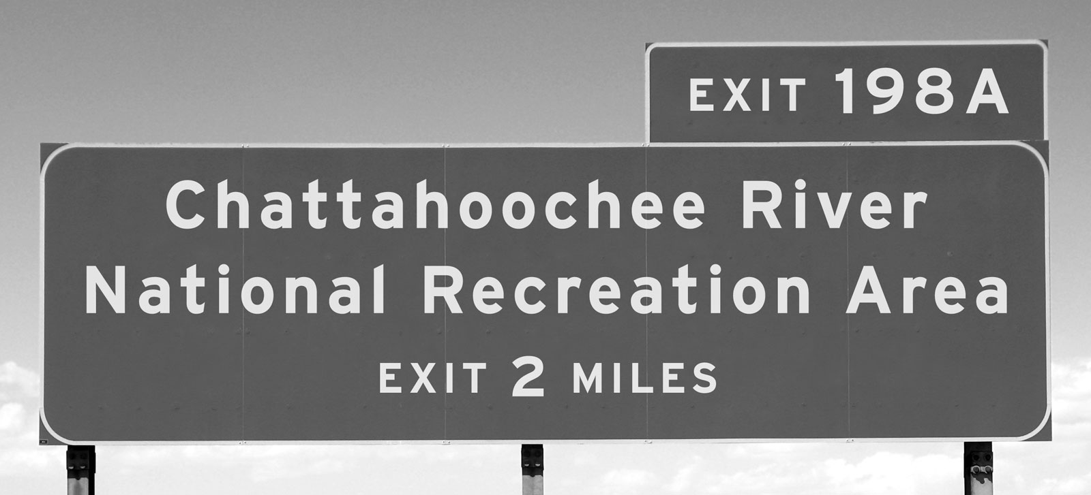
https://practicaltypography.com/why-typography-matters.html

Slide 14
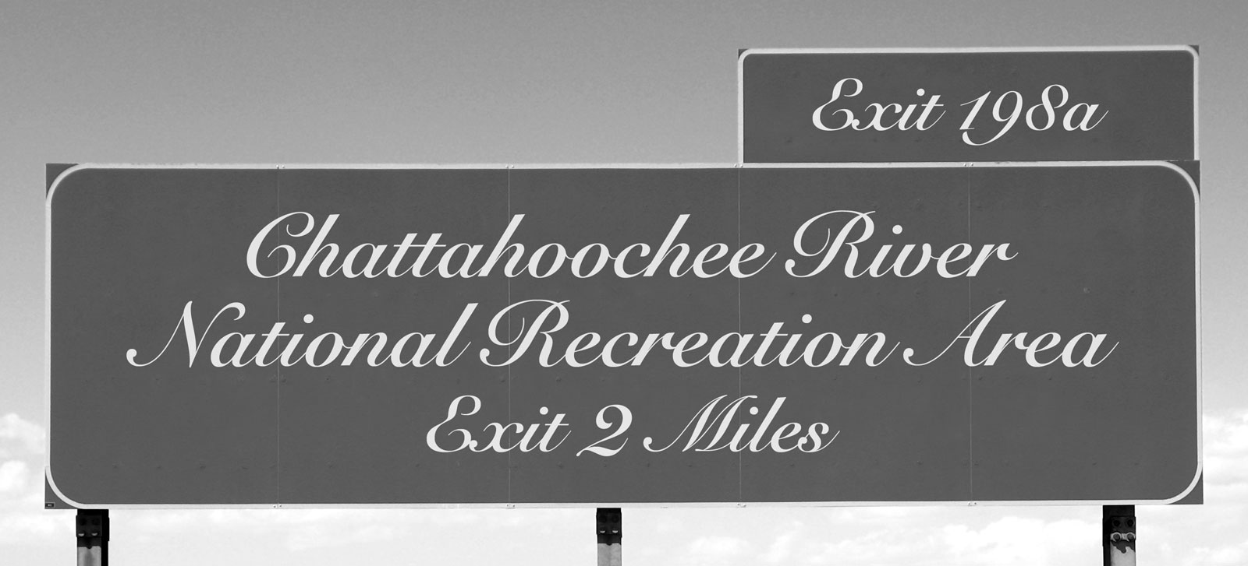

Slide 15
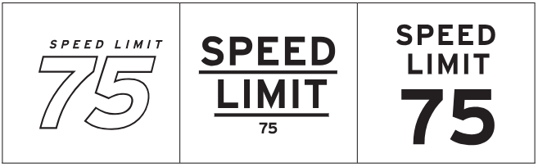

Slide 16
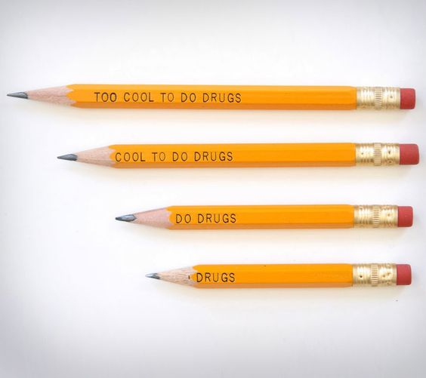
Notes:
https://www.pinterest.com/pin/575194183630478973/
The 'Too Cool To Do Drugs' pencils are pencils that were given to kids in the 90's as a drug slogan to help deter drug use, the only problem was, once they actually started using the pencils and start...

Slide 17
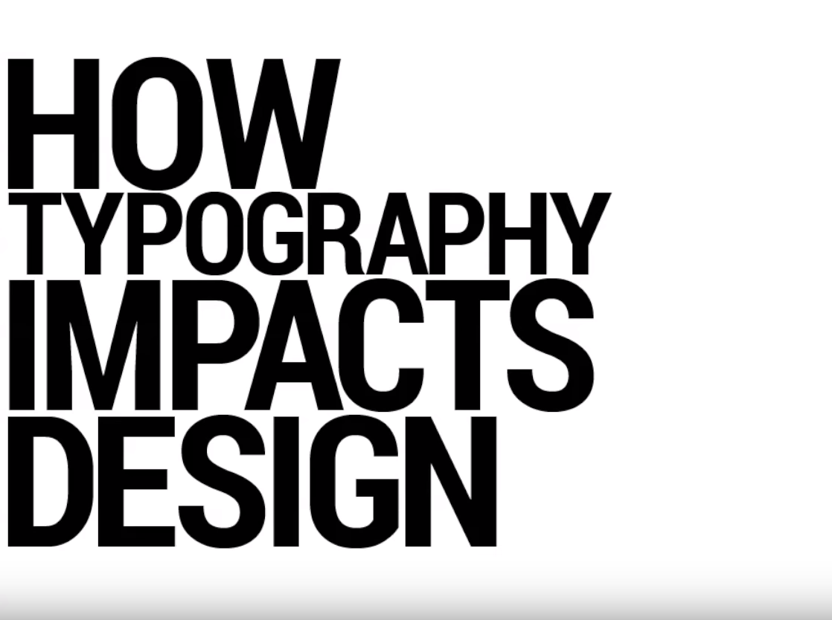
Notes:
https://www.youtube.com/watch?v=mBoVoj5jLfc&list=PLiSLmNEMcc9AJoMYAJIKXquqKJIE-B4V7

Slide 18
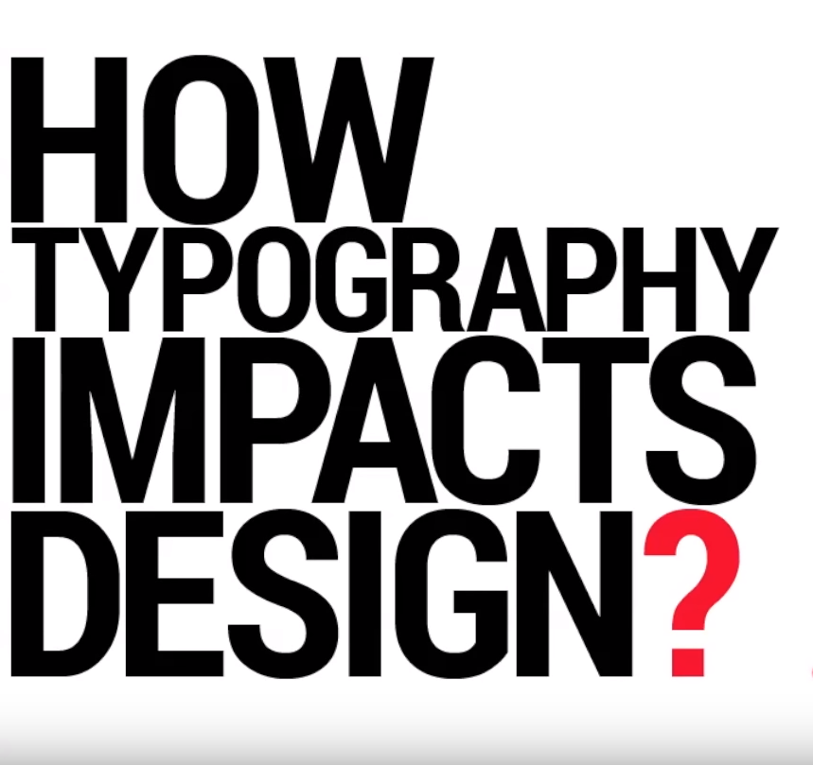
Notes:
Emphasize
Draw attention

Slide 19
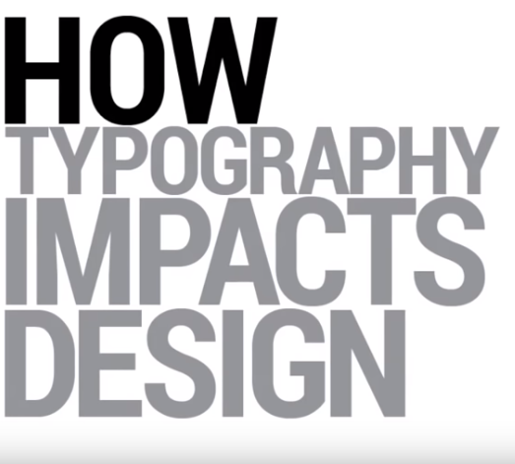

Slide 20
Some Terms to Know

Slide 21
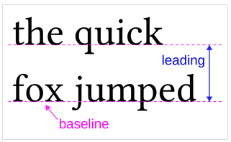
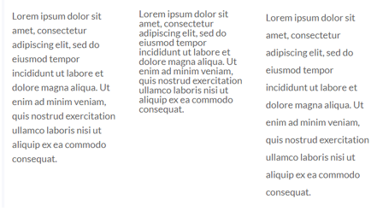
Leading-the distance between the baselines of successive lines of type
The quick brown fox jumps over the lazy dog - Wikipedia

Slide 22
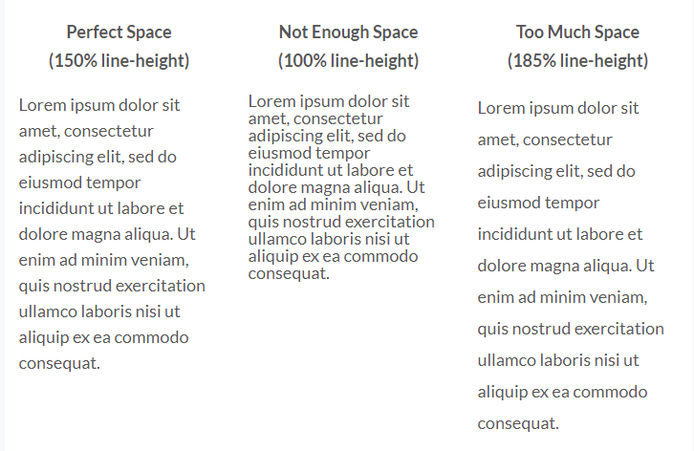
The magic number for line-height: 150% of the font size you are using
If you are using 24px font size, the line-height will be 36px (which is 150% of 24px):
Notes:
https://www.websitebuilderexpert.com/designing-websites/pick-best-font-style-for-website/

Slide 23
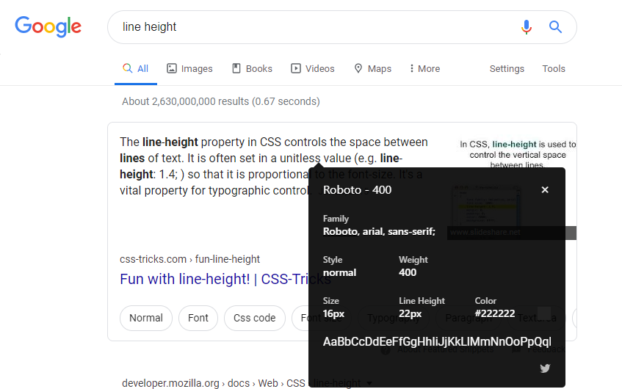
Google’s ratio is for line height 22/16 = 1.375

Slide 24
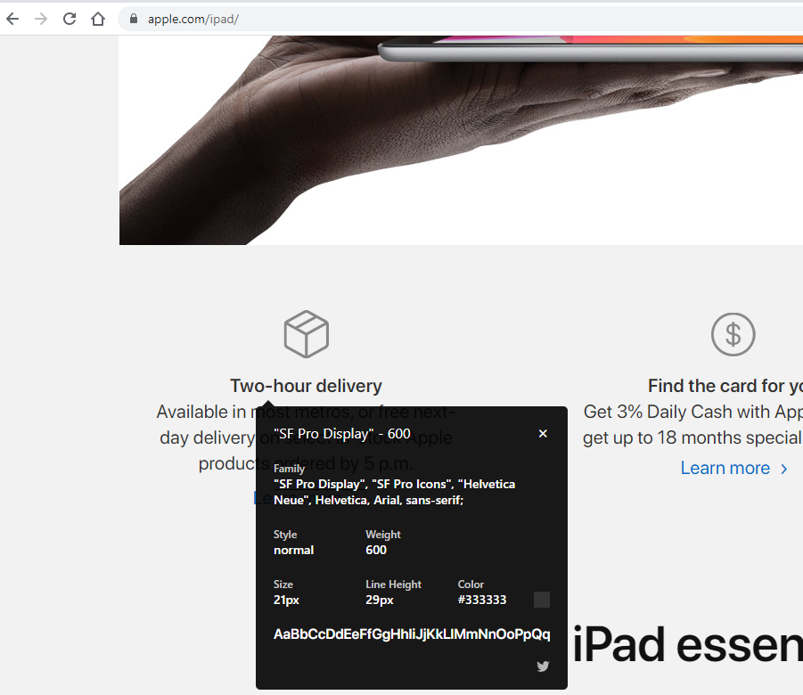
Apple’s ratio for line height is 29/21 = 1.381

Slide 25
Ratios of Existing Websites
Twitter bootstrap’s ratio between the font size and the line height: 1.4
HTML5 boilerplate: 1.4
Medium and zurb foundation: 1.5
Adobe topcoat: 1.3
and yahoo purecss: 1.58
https://medium.com/@zkareemz/golden-ratio-62b3b6d4282a

Slide 26
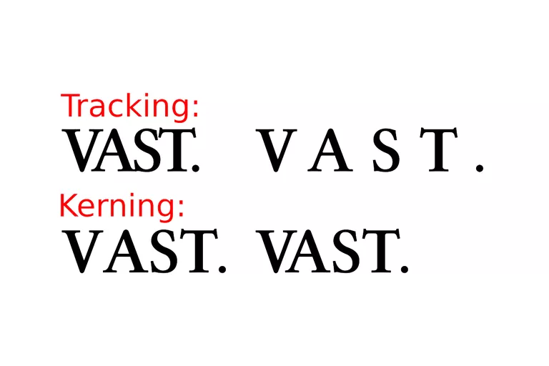
Tracking/Letter-spacing refers to the overall spacing of a word or block of text affecting its overall density
https://graphicdesign.stackexchange.com/questions/2606/difference-between-kerning-vs-letter-spacing

Slide 27
Kerning-the spacing between specific letters
Kerning is about visual space, not actual space

Slide 28
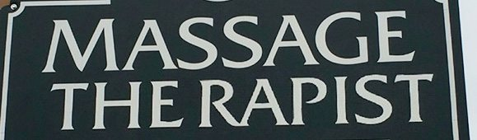
Kerning-the spacing between specific letters
https://www.thebookdesigner.com/2017/05/bad-typography/

Slide 29
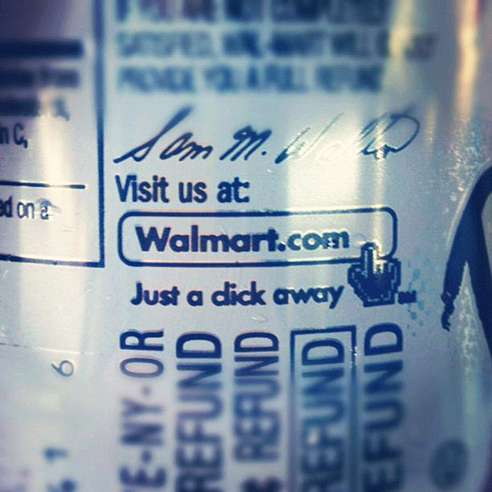

Slide 30
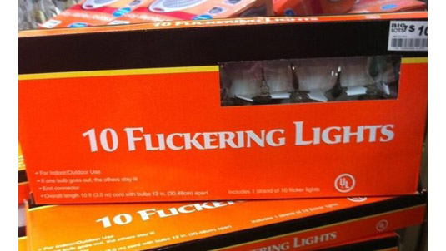

Slide 31
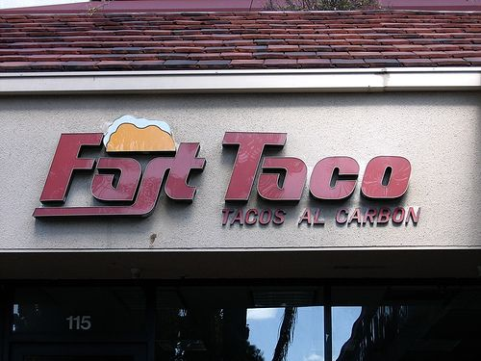

Slide 32
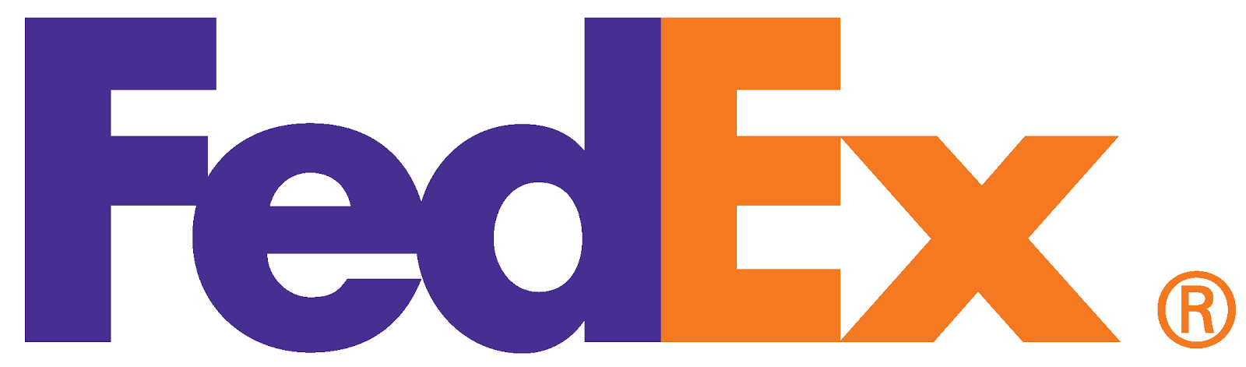

Slide 33
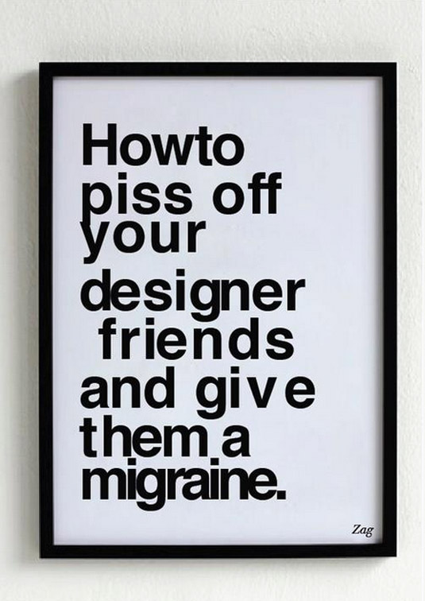
Notes:
https://www.creativebloq.com/typography/5-embarrassing-examples-bad-kerning-91412894

Slide 34
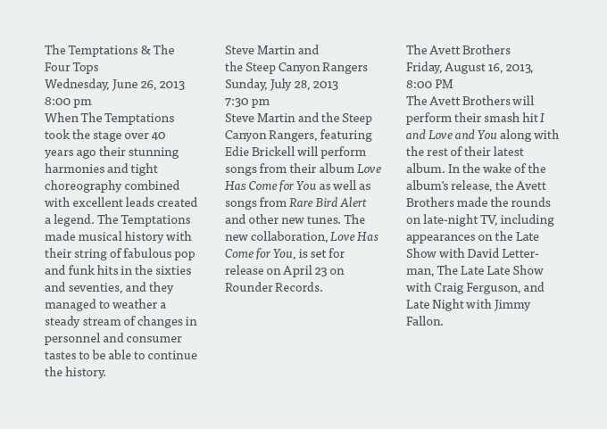
Hierarchy- an order of importance
https://webdesign.tutsplus.com/articles/understanding-typographic-hierarchy--webdesign-11636

Slide 35
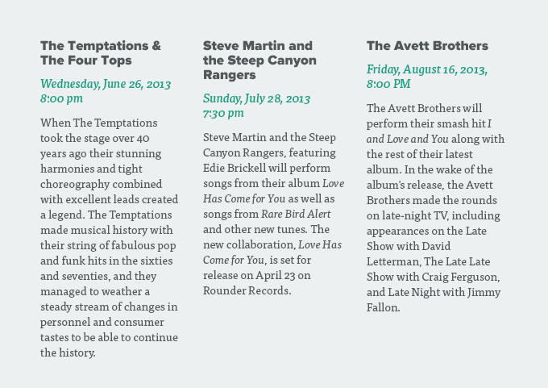

Slide 36
Styling Techniques
There are a few basic methods for establishing a visual typographic hierarchy:
Size
Weight
Color
Position
Type Contrast

Slide 37
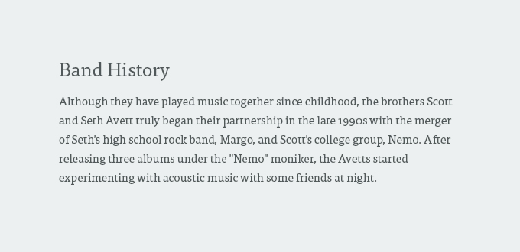
Size

Slide 38
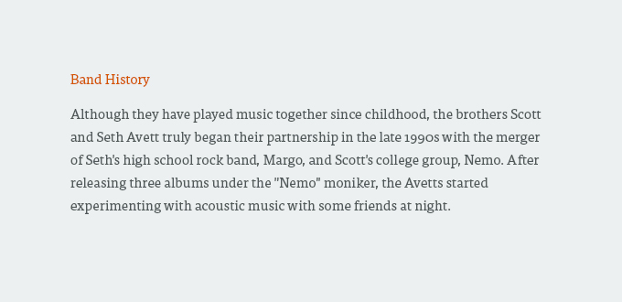
Color

Slide 39
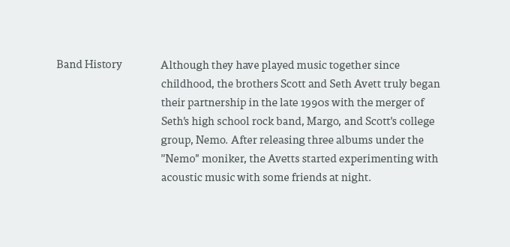
Position

Slide 40
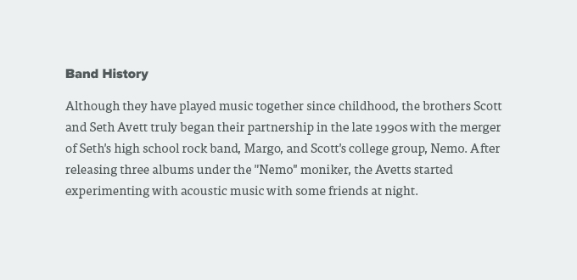
Contrasting Typefaces
Rule-of-thumb: combining a sans-serif with a serif typeface

Slide 41
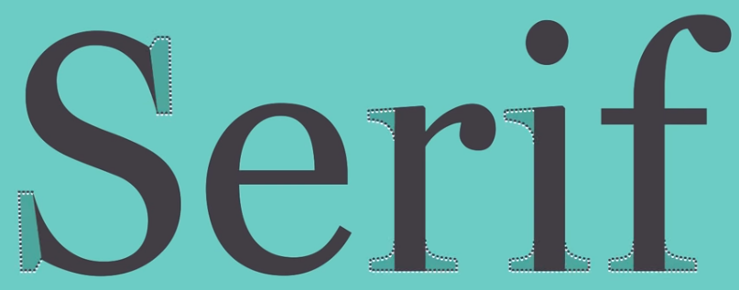
Serif

Slide 42
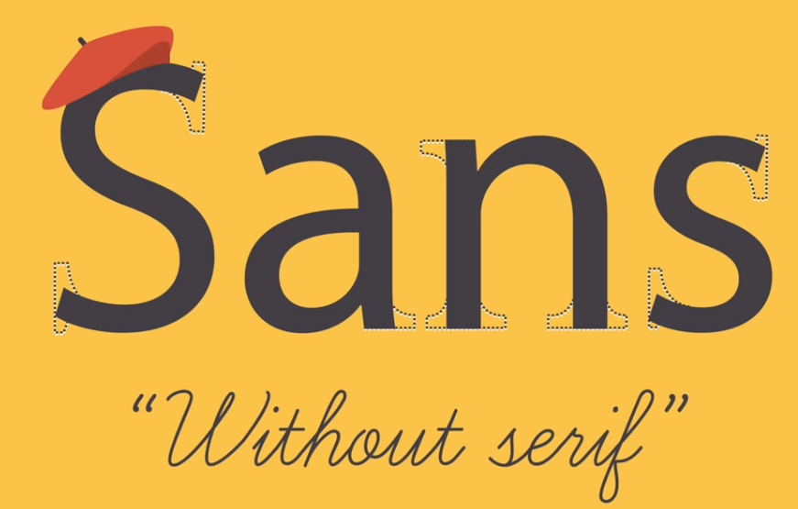
Sans Serif

Slide 43
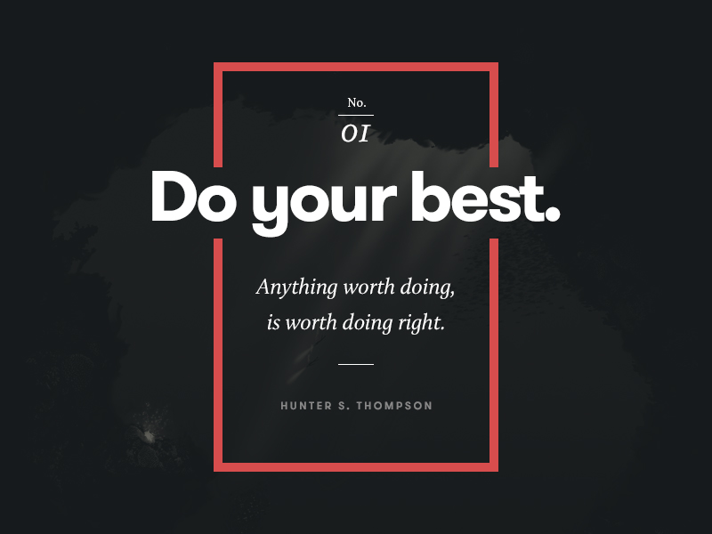
https://www.canva.com/learn/typeface-fonts/

Slide 44
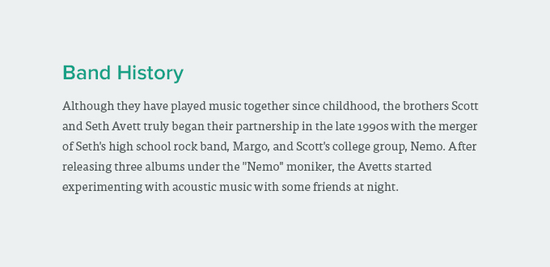
Combination

Slide 45
Web Fonts & Web Safe Fonts

Slide 46

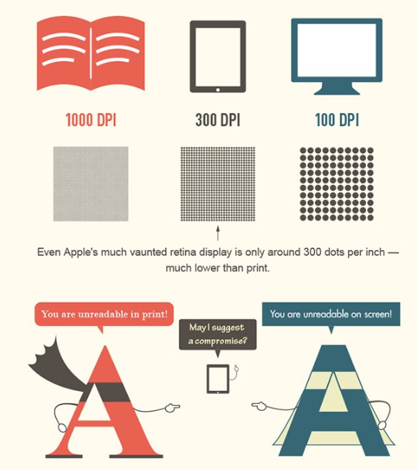
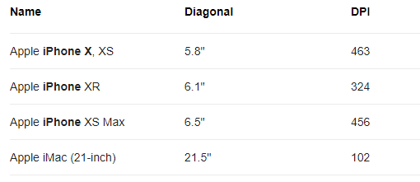
Serif vs. Sans Serif
Serif- newspapers, books
Sans serif-web use
pixels per inch
https://about.easil.com/support/serif-vs-sans-serif/
Notes:
https://medium.com/rareview/typography-on-the-web-4cd494d6b165
Serif fonts are easily readable at small body copy sizes, and Sans Serif fonts really stand out in large titles.
dots (or pixels) per inch:
Pixel density

Slide 47
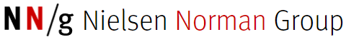
Serif vs. Sans-Serif Fonts for HD Screens
“The old usability guideline for online typography was simple: stick to sans-serif typefaces. Because computer screens were too lousy to render serifs properly, attempting serif type at body-text sizes resulted in blurry letter shapes. …”
“Unfortunately, the new guideline is not as clear-cut as the old one. Legibility research is inconclusive as to whether serif fonts are truly better than sans serif.”
https://www.nngroup.com/articles/serif-vs-sans-serif-fonts-hd-screens/
Notes:
high definition

Slide 48
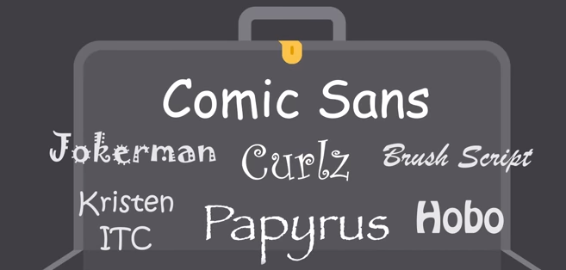
Fonts with reputation of being outdated and overused
https://www.youtube.com/watch?v=sByzHoiYFX0

Slide 49
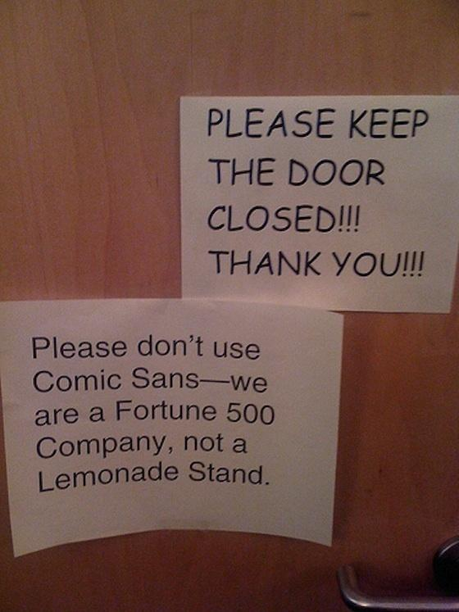

Slide 50
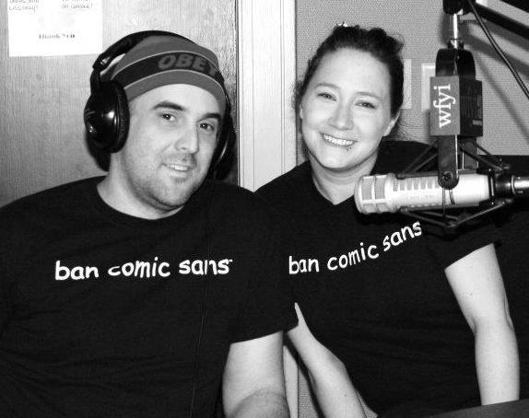
The "Ban Comic Sans" movement began in September 2002
https://knowyourmeme.com/memes/comic-sans

Slide 51
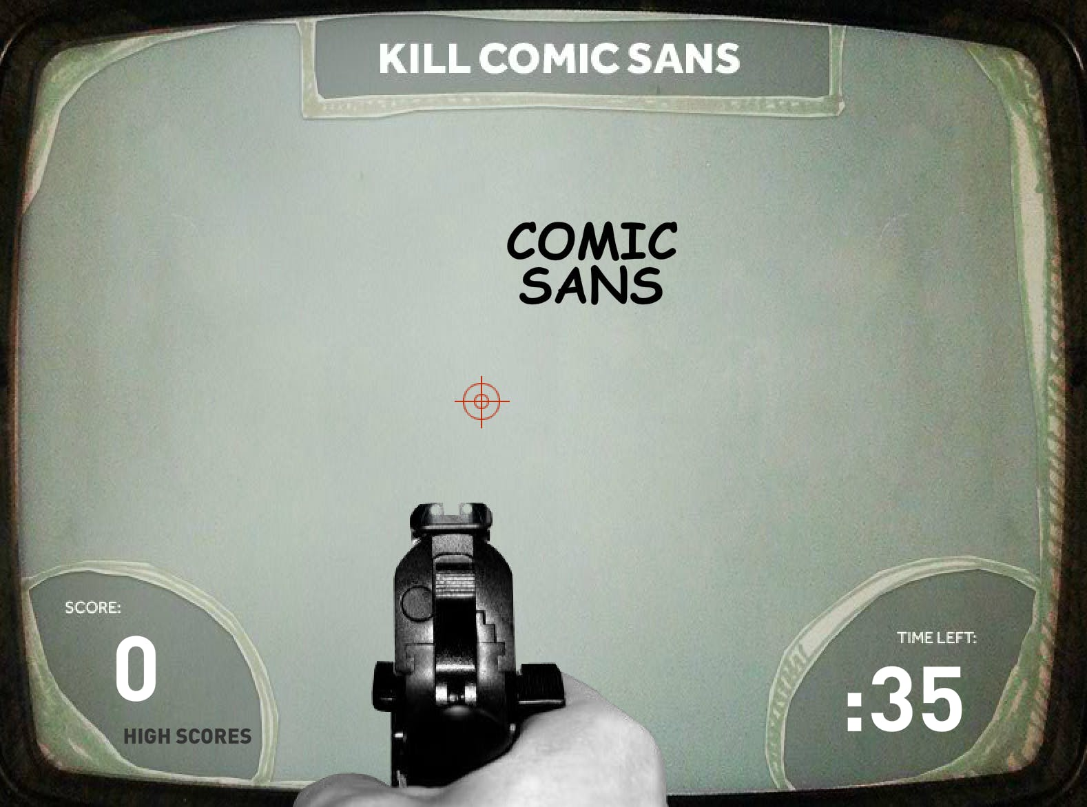
Notes:
In October 2011, ad agency AgencyFusion^{[5]} released the Flash-based shooting game "Kill Comic Sans":
https://idealog.co.nz/design/2011/10/kill-comic-sans-fatal-fontfoolery

Slide 52
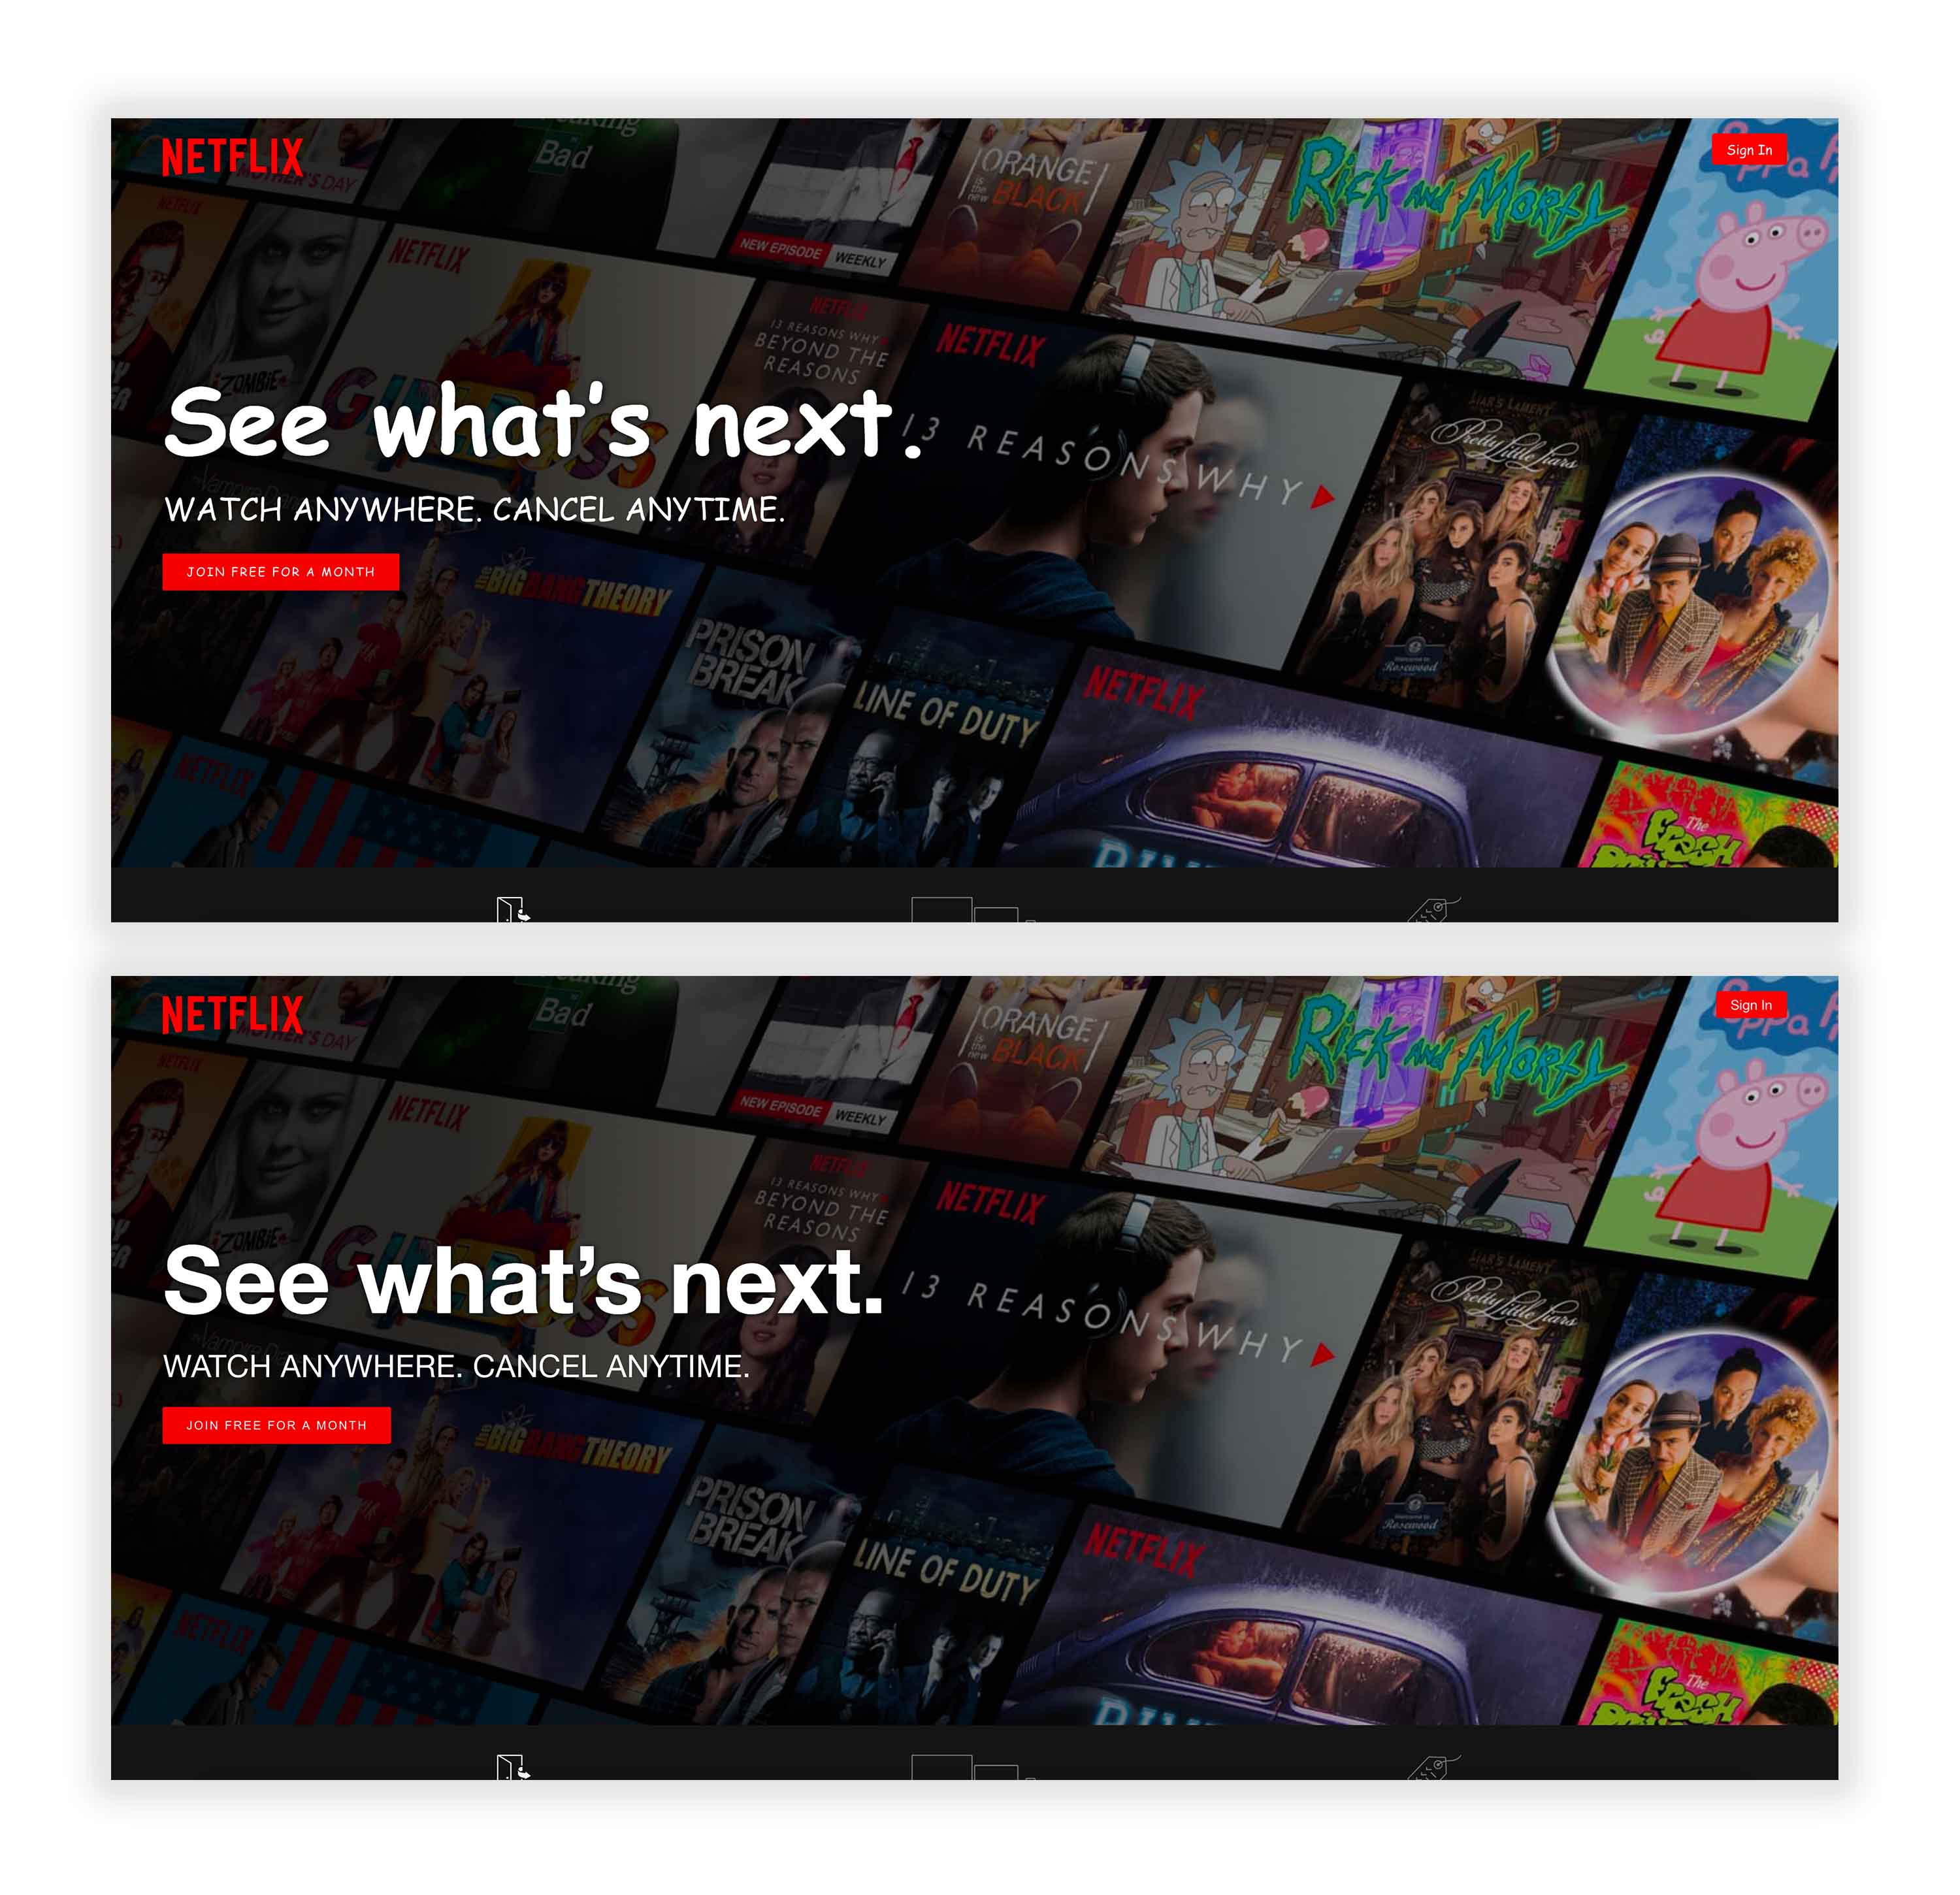
Notes:
https://madebyshape.co.uk/web-design-blog/your-website-in-comic-sans

Slide 53
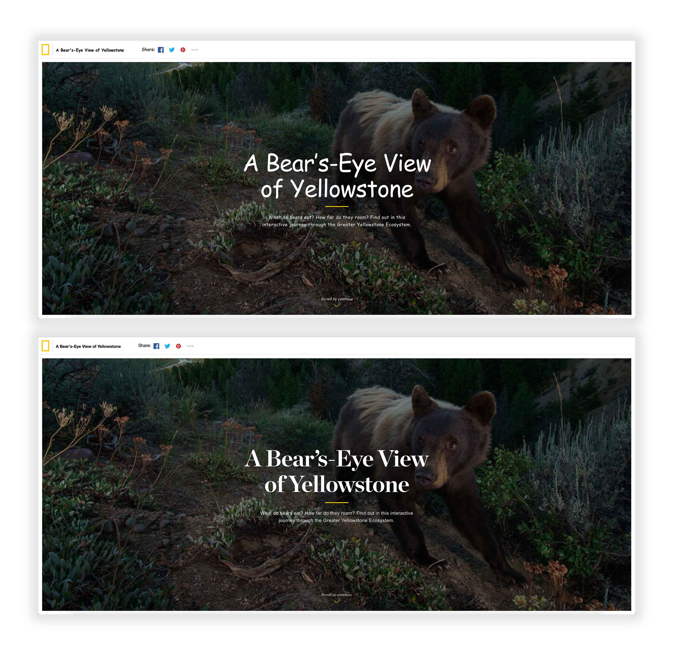

Slide 54
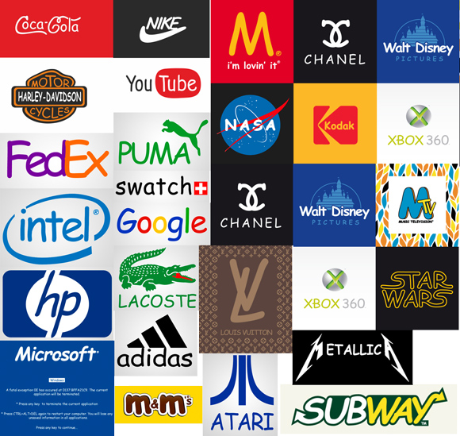
Designer redesigned the logos of famous brands using Comic Sans
Notes:
https://www.omniconvert.com/blog/comic-sans-homepage-redesign.html

Slide 55

Font-family property
The font-family property should hold several font names as a "fallback" system, to ensure maximum compatibility between browsers/operating systems.
If the browser does not support the first font, it tries the next font.
Start with the font you want, and end with a generic family, to let the browser pick a similar font in the generic family, if no other fonts are available.
p { font-family: "Times New Roman", Times, serif; }

Slide 56
Web fonts
<html> <head> <link rel="stylesheet" href="https://fonts.googleapis.com/css?family=Tangerine"> <style> body { font-family: 'Tangerine', serif; font-size: 48px; } </style> </head> <body> <div>Making the Web Beautiful!</div> </body> </html>
Google Web Fonts
Adobe Fonts
https://fonts.google.com/
https://websitesetup.org/web-safe-fonts-html-css/
Notes:
<html>
<head>
<link rel="stylesheet" href="https://fonts.googleapis.com/css?family=Tangerine">
<style> body { font-family: 'Tangerine', serif; font-size: 48px; } </style>
</head>
<body> <div>Making the Web Beautiful!</div> </body>
</html>

Slide 57
Web safe fonts
Web safe fonts are fonts that are more likely to be present on a large number of computer systems.
Choosing web safe fonts increases the chances that your content will be displayed in the chosen font.
If a font is chosen that is not readily available on the users systems the page will render differently than expected.
15 Best Web Safe Fonts
Arial
Roboto
Times New Roman
Times
Courier New…
https://websitesetup.org/web-safe-fonts-html-css/
https://www.moorecreative.com/Articles/Detail/tabid/522/ArticleId/11/What-are-Web-Safe-Fonts.aspx

Slide 58
Tools for Typography
WhatFont
https://chrome.google.com/webstore/detail/whatfont/jabopobgcpjmedljpbcaablpmlmfcogm?hl=en
Font Squirrel
7 typography tools
https://www.creativebloq.com/features/7-new-typography-tools-for-2017

Slide 59
Summary
Typography
Leading
Kerning
Tracking
Hierarchy

Slide 60
Review questions
What are the methods for establishing a visual typographic hierarchy?
What the magic number for line-height/font size?
3. What is the difference between Serif and Sans serif? Which one is widely used on websites?
4. Are Web fonts and Web safe fonts the same? If not, what are the differences?

